Slide 1

Data Mining with R
For Internal Purposes Only
This presentation is solely for the use of client personnel. No part of it may be circulated, quoted or reproduced for distribution outside of the client organization without prior written approval of ZS Associates.
ZS Associates | 847.492.3600 | www.zsassociates.com

Slide 2
Agenda
What is R, and what can we use it for?
The basics
Data manipulation and visualization
Case study: Baby names
Predictive modeling
Case study: Surviving the Titanic

Slide 3








R is a complete tool for data manipulation, visualization, and modeling
What is R?
The power of R
R’s capabilities versus other tools
Data manipulation
Data visualization
Data modeling
Data manipulation
Data visualization
Predictive modeling
Optimization
User interface
Legend:
Low performing
High performing

Slide 4
…but R is not the best tool for everything
What is R?
When to use R
When to use Excel
When to use SAS
Data exploration
Heavy data manipulation
Designing durable processes
Newer types of predictive modeling
Designing durable processes
Nice presentation
Quick and dirty number crunching
Simple optimization (e.g. Solver)
Models for clients
Big data
Heavy data manipulation
Designing durable processes
Multi-user process development

Slide 5


With R, we can build and interpret models quickly in the same platform, speeding up the delivery of business analytics
Old School
New School
Separation between modeling & interpretation slows down how quickly we can get to a viable solution
R allows us to combine modeling, interpretation, and visualization under one platform, speeding up analytics
Data Manipulation
Data Manipulation & Modeling
Modeling, Interpretation, & Visualization
Model Interpretation, Visualization, & Delivery
Delivery

Slide 6
What types of projects have I used R for?
 | Assess both potential and receptivity of customers Develop receptivity scores for customers based on demonstrated behavior
 | Segment customers based on their attitudes and behaviors Segments have varying brand potential and different messaging implications
 | Assess demand for product in different scenarios (product attributes, patient subpopulations, etc.) Understand how behaviors change as a result of market events
 | Understand how differences in a product’s underlying attributes impact it usage in the marketplace Common approach for products still in clinical trials
 | Identifiers influences of physician behavior Identify/validate academic KOLs as well as clinical KOLs
Targeting
Segmentation
Demand Estimation/Forecast
Conjoint
Influence Mapping

Slide 7
What has your experience been with R?
Types of Projects
Things You’ve done with R
Problems with R
…
…
…
We’re starting a pilot to improve support for R as an analytics platform at ZS. We want your feedback; it will help us tailor our training/onboarding materials and feed into development of ZS-specific R packages.

Slide 8
Agenda
What is R, and what can we use it for?
The basics
Data manipulation and visualization
Case study: Baby names
Predictive modeling
Case study: Surviving the Titanic

Slide 9
R’s data structure resembles that of other programming languages
R Basics
R’s core data types
R’s capabilities versus other tools
Numeric
Character
 | Linear | Rectangular
Homogenous | Vector | Matrix
Heterogeneous | List | Data Frame
Logical
Factor
Factors have a finite number of levels and act as categorical variables for models
Matrices, unlike, data frames, can only have one type of data (e.g. only numeric or only character)
Equivalent of SAS dataset

Slide 10
Basic toolkit
R Basics
Function | Syntax | What it does
READ.CSV | mydata <- read.csv( file = "mydata.csv", stringsAsFactors = FALSE, header = TRUE, sep = “,”) | Read to CSV
WRITE.CSV | write.csv( mydata, file = “mydata_out.csv”, row.names = FALSE, na = NA) | Write to CSV
APPLY | apply(data, c(1, 2), function(x) … ) | Apply function over rows and/or columns
TABLE | table(data$field1, data$field2) | Count across levels (ZSLIST)
DIM / LENGTH | dim(data)/length(vector | Size/length
MERGE | merge(x, y, by = c(…), all.x = TRUE) | Merge
ARRANGE | arrange(mydata, age) | Sort
SUBSET | subset(mydata, age <= 50, select = c(“full_name”, “age”)) | Filter rows and/or columns
MUTATE | mydata <- mutate(mydata, full_name = paste(first_name, last_name), age = 2013 – dob) | Add variables as function of existing variables
HELP | help(merge) | View documentation for a function

Slide 11
The plyr package implements the split-apply-combine framework, which is used for data transformations
R Basics
The split-apply-combine framework
Split up a big dataset
Apply a function to each piece
Combine all the pieces back together
Data
Piece
Piece
Data
Piece
Piece
Split
Apply Function to Each Piece
Combine
Piece
Piece
Piece
Piece
Piece
Piece
Piece
Piece
This framework can be used to reduce the level of the data (e.g. aggregate to a certain level) or simply transform the data without changing its level (e.g. rank a field within a level)

Slide 12
The ddply function is the workhorse of the plyr package
R Basics
The split-apply-combine framework
Split up a big dataset
Apply a function to each piece
Combine all the pieces back together
ddply from plyr package
Input
How to split up
Function to apply to each piece
# Split
pieces <- split(mydata, list(mydata$bucket))
# Apply
results <- vector("list", length(pieces))
for(i in seq_along(pieces)) {
piece <- pieces[[i]]
piece <- transform(piece,
rank = rank(-rankvar, ties.method = "first"))
results[[i]] <- piece
}
# Combine
result <- do.call("rbind", results)
# Or equivalently
mydata <- ddply(mydata, c(“bucket"), transform,
rank = rank(-rankvar,
ties.method = "first"))
2nd argument to transform
Use “transform” when the level of the data is not changing (e.g. rank, cumulative sum)
Use “summarise” if reducing data to smaller level (e.g. sum, min, max)

Slide 13
The reshape package assists with normalization and de-normalization transformations
R Basics
Melt & Cast
Melt
norm <- melt(sales, id = c(“Id”))
Id | Time | Sales
A | Sales Today | 10
A | Sales Yesterday | 8
A | Sales Two Days Ago | 7
B | Sales Today | 20
B | Sales Yesterday | 40
B | Sales Two Days Ago | 42
C | Sales Today | 3
C | Sales Yesterday | 19
C | Sales Two Days Ago | 8
De-normalized
Id | Sales Today | Sales Yesterday | Sales Two Days Ago
A | 10 | 8 | 7
B | 20 | 40 | 42
C | 3 | 19 | 8
Normalized
denorm <- cast(norm, id ~ time, value = “sales”, fun.aggregate = “sum”)
Cast

Slide 14
Agenda
What is R, and what can we use it for?
The basics
Data manipulation and visualization
Case study: Baby names
Predictive modeling
Case study: Surviving the Titanic

Slide 15
Case Study: Baby Names
Baby Names
Baby Names Dataset
Top 1000 male and female baby names in the U.S. from 1880 to 2008
1000 names * 2 genders * 129 years = 258,000 records
Only 4 variables: year, name, sex, percent of names
> head(bnames, 10)
year name percent sex
1 1880 John 0.081541 boy
2 1880 William 0.080511 boy
3 1880 James 0.050057 boy
4 1880 Charles 0.045167 boy
5 1880 George 0.043292 boy
6 1880 Frank 0.027380 boy
7 1880 Joseph 0.022229 boy
8 1880 Thomas 0.021401 boy
9 1880 Henry 0.020641 boy
10 1880 Robert 0.020404 boy
> tail(bnames, 10)
year name percent sex
257991 2008 Jamiya 0.000129 girl
257992 2008 Kathy 0.000129 girl
257993 2008 Laylah 0.000129 girl
257994 2008 Riya 0.000129 girl
257995 2008 Diya 0.000128 girl
257996 2008 Carleigh 0.000128 girl
257997 2008 Iyana 0.000128 girl
257998 2008 Kenley 0.000127 girl
257999 2008 Sloane 0.000127 girl
258000 2008 Elianna 0.000127 girl

Slide 16
Case Study: Baby Names Summarizing the data
Baby Names
Summaries
Create a summaries for the following:
% of name that is vowels
Name length
First letter of name
Last letter of name
How has name popularity, by first letter, over time changed?
How has the % of people having top 100 names changed over time?
Investigate how the popularity of top 20 names has changed over time

Slide 17
Case Study: Baby Names Some quick summaries
Baby Names
Make some useful functions & apply
Make some summaries
letter <- function(x, n = 1) {
if (n < 0) {
nc <- nchar(x)
n <- nc + n + 1
}
tolower(substr(x, n, n))
}
vowels <- function(x) {
nchar(gsub("[^aeiouAEIOU]", "", x)) /
nchar(x)
}
bnames <- mutate(bnames,
first = letter(name, 1),
last = letter(name, -1),
length = nchar(name),
vowels = vowels(name)
)
ddply(bnames, c("first"), summarise,
tot = sum(percent) /
sum(bnames$percent))
ddply(bnames, c("last"), summarise,
tot = sum(percent) /
sum(bnames$percent))
with(bnames,
sum(length * percent) / sum(percent))
temp <- bnames[!duplicated(bnames$name),]
head(arrange(temp, -length))
head(arrange(temp, vowels))
head(arrange(temp, -vowels))
~6
Regular expressions!
Bartholomew!
Lynn, Byrd!
Louie!

Slide 18
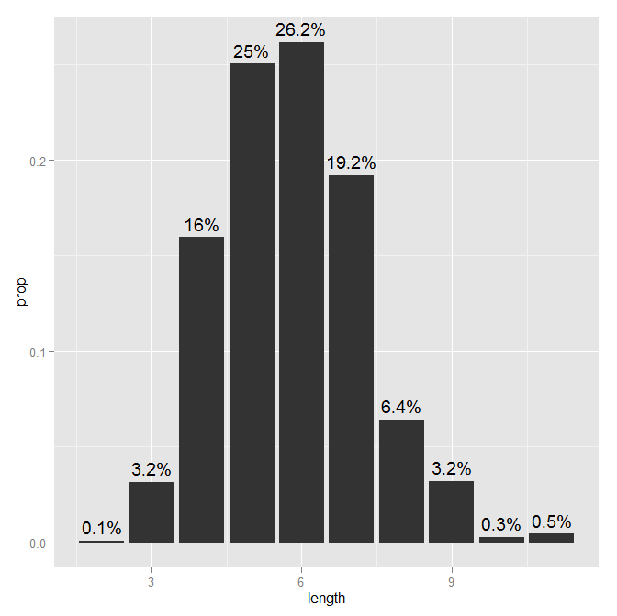
Case Study: Baby Names Summary of name length
Baby Names
Summary of name length
temp <- ddply(bnames, c("length"), summarise,
prop = sum(percent) / sum(bnames$percent))
windows()
ggplot(temp, aes(
x = length,
y = prop)) +
geom_bar(stat = "identity") +
geom_text(aes(
label = paste(round(prop * 100, 1), "%", sep = "")
), vjust = -0.5)

Slide 19
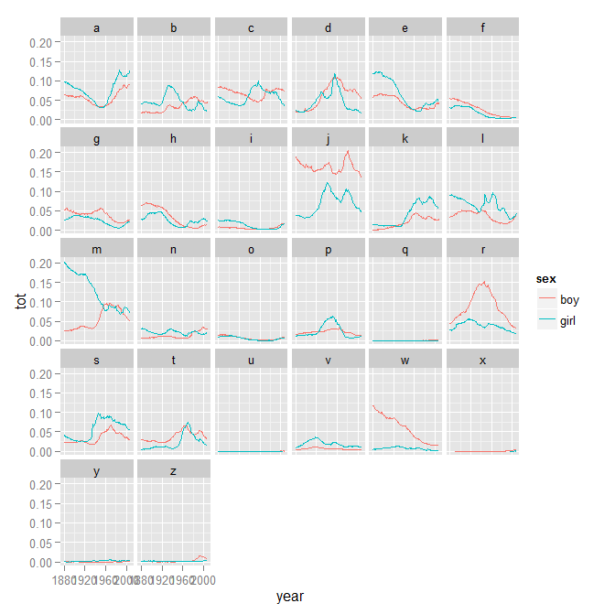
Case Study: Baby Names Summary of name popularity over time by first letter
Baby Names
Summary of name popularity over time by first letter
fl <- ddply(bnames,
c("year", "sex", "first"),
summarise, tot = sum(percent))
windows()
ggplot(fl) +
geom_line(aes(
x = year,
y = tot,
colour = sex)) +
facet_wrap(~ first, ncol = 6)

Slide 20
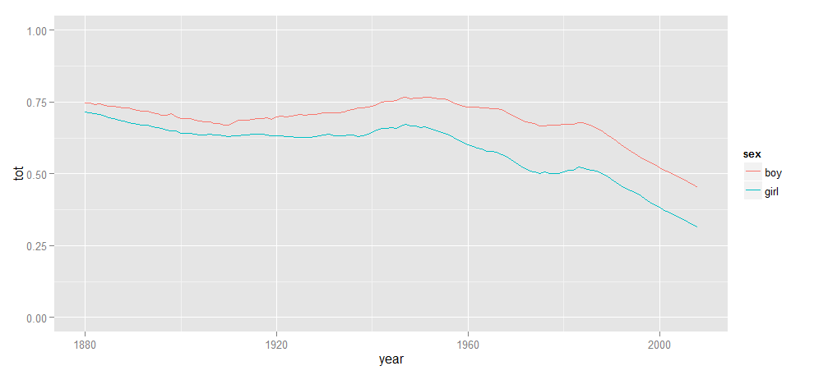
Case Study: Baby Names Popularity of “common” names over time
Baby Names
Proportion of people with top 100 names over time
bnames <- arrange(bnames, year, sex, -percent)
bnames$count <- 1
top100 <- ddply(bnames, c("year", "sex"), transform, count = cumsum(count))
top100 <- subset(top100, count <= 100)
top100 <- ddply(top100, c("year", "sex"), summarise, tot = sum(percent))
ggplot(top100)+geom_line(aes(x = year, y = tot, group = sex, colour = sex))+scale_y_continuous(limits = c(0, 1))
“Donald” still not top 100 though…

Slide 21
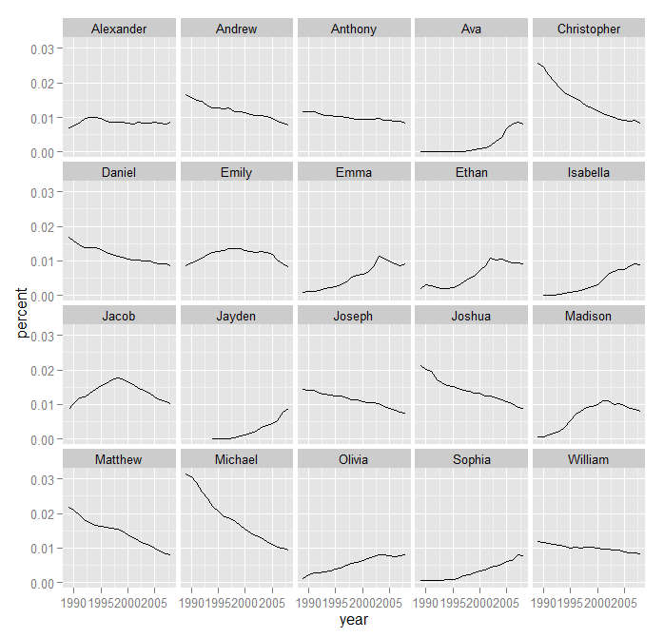
Case Study: Baby Names Most popular names of 2008 over the last 20 years
Baby Names
Most popular names of 2008 over the last 20 years
top20 <- head(arrange(subset(bnames,
year == 2008), -percent)$name, 20)
top20 <- subset(bnames,
name %in% top20 &
year >= 1989)
top20 <- ddply(top20,
c("year", "name"), summarise,
percent = sum(percent))
windows()
ggplot(top20) +
geom_line(aes(
x = year,
y = percent)) +
facet_wrap(~ name, ncol = 5)
Twilight!

Slide 22
Agenda
What is R, and what can we use it for?
The basics
Data manipulation and visualization
Case study: Baby names
Predictive modeling
Case study: Surviving the Titanic

Slide 23
Case Study: Surviving the Titanic
Titanic
Titanic Survivor Dataset
From Kaggle (site that hosts data mining competitions; good source of public data!)
Have data on 891 passengers and whether or not they survived (hint: not Leo)
> head(titanic)
PassengerId Survived Pclass Name Sex Age SibSp Parch Ticket Fare Cabin Embarked
1 1 0 3 Braund, Mr. Owen Harris male 22 1 0 A/5 21171 7.2500 S
2 2 1 1 Cumings, Mrs. John Bradley (Florence Briggs Thayer) female 38 1 0 PC 17599 71.2833 C85 C
3 3 1 3 Heikkinen, Miss. Laina female 26 0 0 STON/O2. 3101282 7.9250 S
4 4 1 1 Futrelle, Mrs. Jacques Heath (Lily May Peel) female 35 1 0 113803 53.1000 C123 S
5 5 0 3 Allen, Mr. William Henry male 35 0 0 373450 8.0500 S
6 6 0 3 Moran, Mr. James male 28 0 0 330877 8.4583 Q
Survival: Survival (0 = No; 1 = Yes)
Pclass: Passenger Class (1 = 1st; 2 = 2nd; 3 = 3rd)
Name: Name
Sex: Sex
Age: Age
Sibsp: Number of Siblings/Spouses Aboard
Parch: Number of Parents/Children Aboard
Ticket: Ticket Number
Fare: Passenger Fare
Cabin: Cabin
Embarked: Port of Embarkation (C = Cherbourg; Q = Queenstown; S = Southampton)

Slide 24
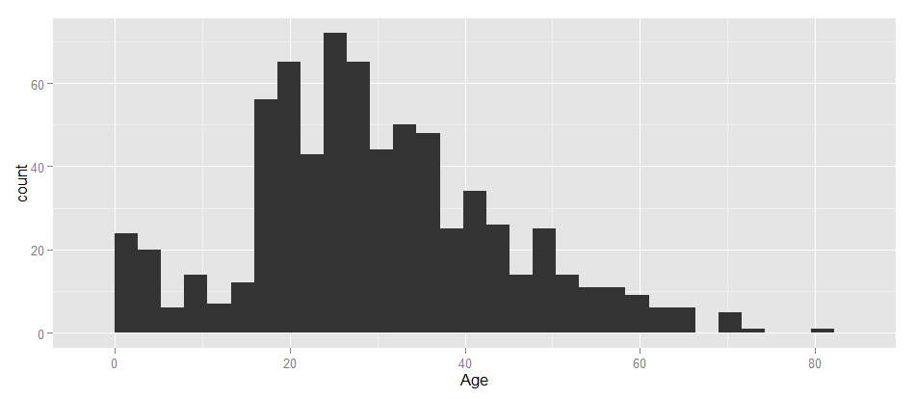
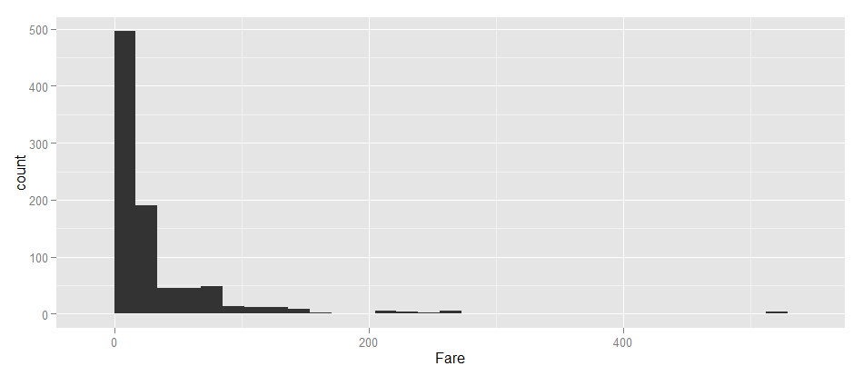
Case Study: Surviving the Titanic Building some predictive models
Titanic
Titanic Survivor Dataset
table(titanic$Survived) # numeric
table(titanic$Pclass) # numeric
table(titanic$Sex) # factor
table(titanic$Embarked) # factor
table(titanic$SibSp) # numeric
table(titanic$Parch) # numeric
windows()
ggplot(titanic) + geom_histogram(aes(x = Age))
windows()
ggplot(titanic) + geom_histogram(aes(x = Fare))
head(arrange(titanic, -Fare))
70% of passengers with top 10 fares survived. Overall survival rate = 38%

Slide 25
Case Study: Surviving the Titanic Predictive model options
Titanic
Predictive Modeling Golden Rules
Cross-validation to prevent overfitting
Sample ≠ Universe: you can’t reliably predict based on inputs you haven’t seen before
“Regression to the mean”
Try lots of approaches
Approach | Pros | Cons
Regression (glmnet) | Simple to understand | Assumes linearity Difficult to handle variable dependencies
Decision Trees (CART) | Handles dependencies well Very logical | Lack of granularity May not capture all of the nuansce of the data
Ensemble Classifiers (RandomForest) | Don’t overfit Very good predictability Good for assessing variable “importance” | “Black box” Difficult to transfer to other platforms (but not impossible)
Frequent Item Sets (apriori) | Output is a simple set of rules | Requires categorical variables
Our focus

Slide 26
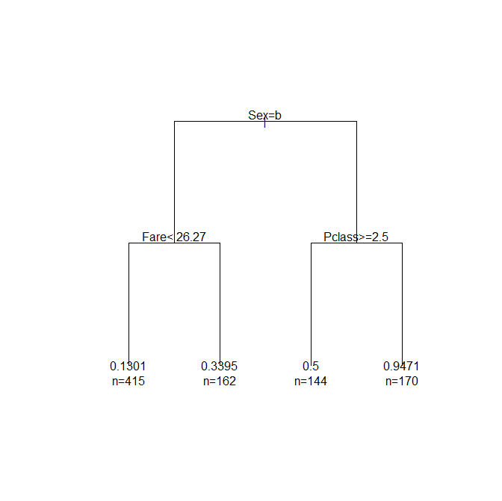
Case Study: Surviving the Titanic Simple decision tree
Titanic
Simple decision tree using rpart package
single.tree <- rpart(
Survived ~ .,
titanic[,c("Survived", "Pclass", "Sex", "Embarked", "SibSp", "Parch", "Age", "Fare", "miss", "mrs")],
control = rpart.control(
minbucket = 50))
single.tree <- prune(single.tree,
cp = single.tree$cptable[
which.min(single.tree$cptable[,"xerror"]), "CP"])
windows()
plot(single.tree, uniform = TRUE,
margin = 0.2)
text(single.tree, use.n = TRUE)
Male
Female

Slide 27
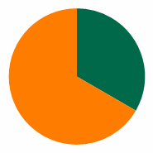
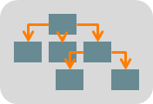
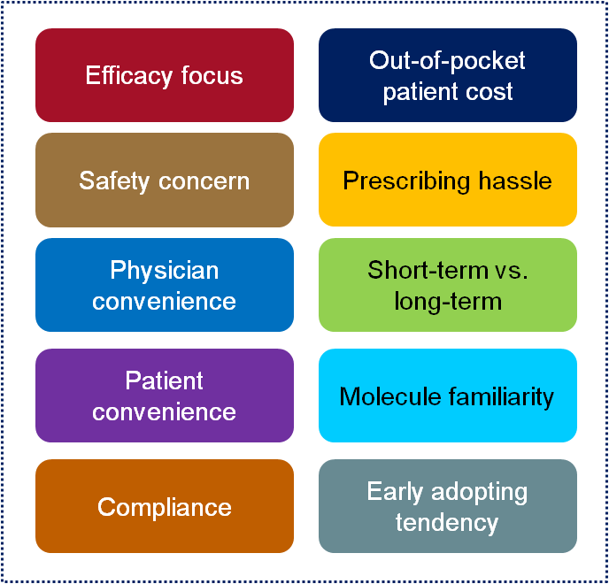
Case Study: Surviving the Titanic How Random Forest works
Titanic
Random Forest
Bootstrapping: each decision tree is built on a random 2/3 of the sample to avoid overfitting
Predictors
Decision Tree
Each tree is made with a random subset of predictors
Uses CHAID/CART-like procedure to determine cut points that maximize differentiation in objective variable
Prediction
Each tree gets a vote. Sum up all the votes. It’s basically just a democracy.

Slide 28
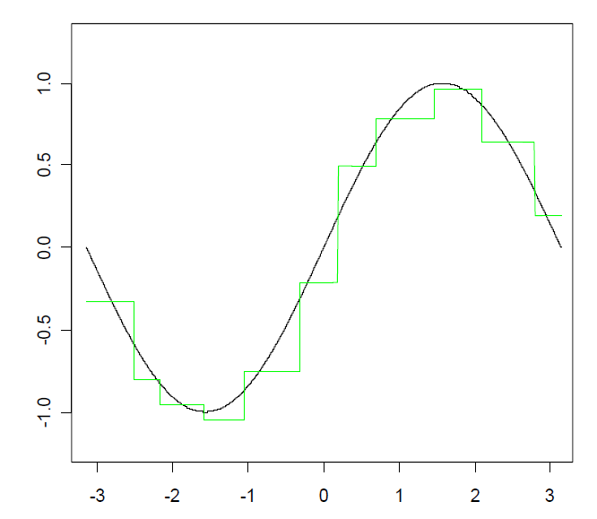
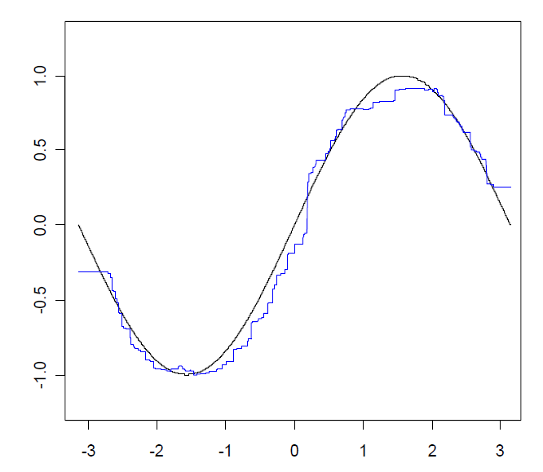
Case Study: Surviving the Titanic How Random Forest works
Titanic
Single Decision Tree
Random Forest

Slide 29
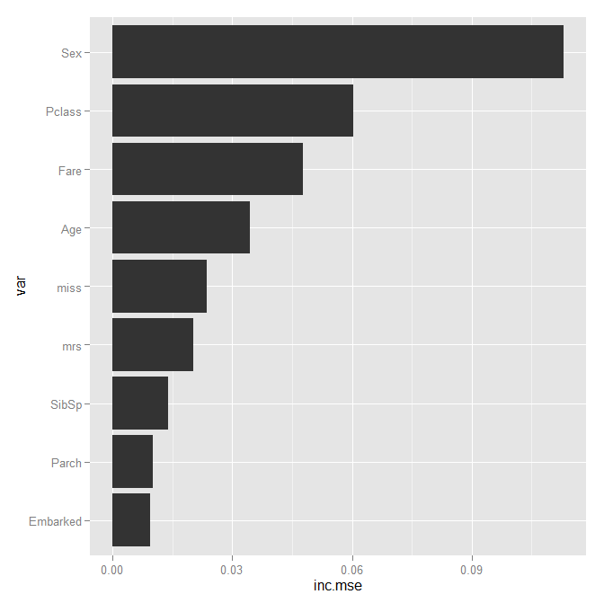
Case Study: Surviving the Titanic Random Forest can help us get a sense for which variables are predictive
Titanic
Using Random Forest to determine variable importance
fit.rf <- randomForest(
Survived ~ .,
data = titanic[,c("Survived", "Pclass",
"Sex", "Embarked", "SibSp", "Parch",
"Age", "Fare", "miss", "mrs")],
ntree = 500, proximity = FALSE,
keep.forest = TRUE, importance = TRUE)
imp.ratings <- data.frame(
var = rownames(fit.rf$importance),
inc.mse = fit.rf$importance[,1],
stringsAsFactors = FALSE)
imp.ratings <- arrange(imp.ratings, inc.mse)
imp.ratings$var <- factor(
imp.ratings$var,
levels = imp.ratings$var, ordered = TRUE)
windows()
ggplot(imp.ratings) +
geom_bar(aes(x = var, y = inc.mse)) +
coord_flip()
Age also very important

Slide 30
Case Study: Surviving the Titanic Thinking about data in terms of frequent item sets is also useful; this is the basis for the apriori algorithm which makes association rules in transactional data
Titanic
If I buy milk, what else am I likely to buy at the grocery store?
Beer → Bread
Beer → Milk
Milk → Beer
Jelly → Bread;
Milk → Bread
Bread → Peanut Butter
Penaut Butter → Bread
Milk → Peanut Butter
Jelly → Peanut Butter
(Jelly, Peanut Butter) → Bread
Jelly → (Bread, Peanut Butter)
(Bread, Jelly) → Peanut Butter
(Milk, Peanut Butter) → Bread
(Bread, Peanut Butter)
(Bread, Milk) → Peanut Butter

Slide 31
Case Study: Surviving the Titanic All variables must be converted into “factors” for apriori
Titanic
Preparing our dataset for apriori
trans <- titanic[,c("Survived", "Pclass", "Sex", "Embarked", "SibSp", "Parch", "Age", "Fare", "miss", "mrs")]
trans$Age <- cut(trans$Age, quantile(trans$Age, probs = c(0, 0.1, 0.9, 1)),
include.lowest = TRUE, labels = FALSE)
trans$Fare <- cut(trans$Fare, quantile(trans$Fare, probs = c(0, 0.1, 0.9, 1)),
include.lowest = TRUE, labels = FALSE)
trans <- mutate(trans,
Survived = ifelse(Survived == 1, "Yes", "No"),
SibSp = ifelse(SibSp > 0, "Yes", "No"),
Parch = ifelse(Parch > 0, "Yes", "No"),
Age = ifelse(Age == 1, "Child", ifelse(Age == 2, "Adult", "Elderly")),
Fare = ifelse(Fare == 1, "Super Saver", ifelse(Fare == 2, "Economy", "Delux")),
miss = ifelse(miss == 1, "Yes", "No"),
mrs = ifelse(mrs == 1, "Yes", "No"))
trans <- as.data.frame(apply(trans, 2, as.factor))

Slide 32
Case Study: Surviving the Titanic Run apriori to find some association rules related to survival specifically
Titanic
Running apriori
rules <- apriori(trans, parameter = list(minlen = 2, support = 0.05, confidence = 0.8),
appearance = list(rhs = c("Survived=No", "Survived=Yes"), default = "lhs"),
control = list(verbose = TRUE))
inspect(head(rules)) # 829 rules though!
lhs rhs support confidence lift
1 {Fare=Super Saver} => {Survived=No} 0.08866442 0.8586957 1.393621
2 {Sex=male} => {Survived=No} 0.52525253 0.8110919 1.316362
3 {Sex=female,
Fare=Delux} => {Survived=Yes} 0.06060606 0.9642857 2.512218
4 {Sex=male,
Age=Elderly} => {Survived=No} 0.05499439 0.8032787 1.303682
5 {Pclass=3,
Fare=Super Saver} => {Survived=No} 0.07519641 0.8375000 1.359221
6 {Sex=male,
Fare=Super Saver} => {Survived=No} 0.08641975 0.9277108 1.505629

Slide 33
Case Study: Surviving the Titanic Run apriori to find some association rules related to survival specifically
Titanic
Pruning apriori rules
# some appear to be redundant; toss em
subset.matrix <- is.subset(rules, rules)
subset.matrix[lower.tri(subset.matrix, diag = TRUE)] <- NA
redundant <- apply(subset.matrix, 2, sum, na.rm = TRUE) > 0
rules.pruned <- rules[!redundant] # 16 rules left; that's more like it
inspect(head(rules.pruned))

Slide 34
Case Study: Surviving the Titanic Run apriori to find some association rules related to survival specifically
Titanic
Final association rules
lhs rhs support confidence lift
1 {Fare=Super Saver} => {Survived=No} 0.08866442 0.8586957 1.393621
2 {Sex=male} => {Survived=No} 0.52525253 0.8110919 1.316362
3 {Sex=female,
Fare=Delux} => {Survived=Yes} 0.06060606 0.9642857 2.512218
4 {Parch=No,
mrs=Yes} => {Survived=Yes} 0.06958474 0.8493151 2.212689
5 {Sex=female,
Embarked=C} => {Survived=Yes} 0.07182941 0.8767123 2.284066
6 {Pclass=2,
Sex=female} => {Survived=Yes} 0.07856341 0.9210526 2.399584
7 {Pclass=1,
Sex=female} => {Survived=Yes} 0.10213244 0.9680851 2.522116
8 {Sex=female,
miss=No} => {Survived=Yes} 0.11896745 0.8030303 2.092105
9 {Pclass=3,
Embarked=S} => {Survived=No} 0.32098765 0.8101983 1.314912
10 {Pclass=3,
miss=No} => {Survived=No} 0.36026936 0.8251928 1.339247
11 {miss=No,
mrs=No} => {Survived=No} 0.52525253 0.8041237 1.305053
12 {Pclass=3,
Age=Adult,
mrs=No} => {Survived=No} 0.33333333 0.8070652 1.309827
13 {Embarked=S,
SibSp=Yes,
Parch=No,
mrs=No} => {Survived=No} 0.05274972 0.8103448 1.315150
lhs rhs support confidence lift
14 {Embarked=S,
SibSp=Yes,
Age=Adult,
mrs=No} => {Survived=No} 0.08080808 0.8275862 1.343132
15 {Embarked=S,
SibSp=No,
Parch=No,
miss=No} => {Survived=No} 0.30864198 0.8136095 1.320448
16 {SibSp=No,
Parch=No,
Age=Adult,
miss=No} => {Survived=No} 0.34118967 0.8000000 1.298361
Cool, but can we look at this visually?

Slide 35
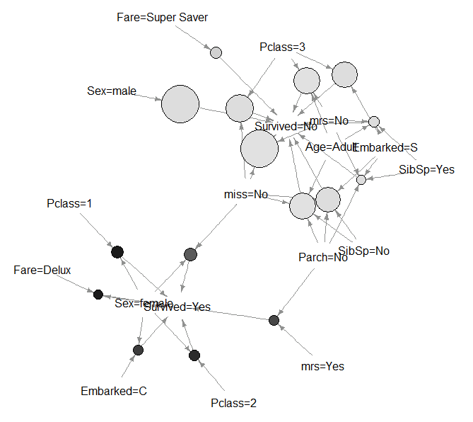
Case Study: Surviving the Titanic Run apriori to find some association rules related to survival specifically
Titanic
Size = support (% population)
Color = lift (predictive certainty)

Slide 36
That’s it! Spread the word!

